Slide 1
IAS 2018 – Amsterdam, july 24th
HIV VL platforms and patient needs Where the market is going ?
Pr Benjamin CORIAT
Université Paris 13, Sorbonne Paris Cité
With thanks to the OPP-ERA teams especially
Pr C. Rouzioux & Dr. N Yakhelef

Slide 2
INTRODUCTION
As it has been shown, on the supply side the offer of VLT platforms have experienced important changes
This opens new opportunities to meet the very different needs on the demand side.
The presentation is dedicated to begin to illustrate the complementarity of the different solutions now provided by the market.
In this context a focus is made on low prevalence countries and their specific needs.

Slide 3
Towards more Flexibility and Poyvalence
Whatever the considered system (IP, OPP, POC…),the evolution is towards more flexibility and polyvalence
Flexibility :
i) a same reagent is accepted by different systems;
ii) a same machine integrates reagents of different origins
iii) numerical flexibility : (Hologic)
Polyvalence : the same platform can perform different tests of infectious diseases (HIV, TB, HBV, HCV)
Emergence of a series of new combinations : trend towards a more diversified offer
Competition through differentiation is now at stake.

Slide 4
An attractive, dynamic and evolving market
Important Mergers & Acquisitions in the sector
(not exhaustive)
Gen-Probe acquired by Hologic (Price : $13.8) in 2012
Hyglos acquired by bioMérieux (Price: $26 million) in 2016
Multiplicom acquired by Agilent Technologies (Price: $72 million cash) in 2016
Exiqon acquired by Qiagen (Price: Approximately $99.6 million) in 2016
Focus Diagnostics’ immunodiagnostic and molecular diagnostic products business acquired by DiaSorin (Price: $300 million) in 2016
Hologic acquired by Grifols (Price: $1.85 billion cash) in 2016
Cepheid acquired by Danaher (Price: Approximately $4 billion) in 2016
Alere Acquired by Abbott Laboratories (Price: $5.3 billion) in 2016
etc…

Slide 5
The demand side : Still the « neglected » dimension of the market … but the key factor driving the changes
The demand (patient and public health actors needs ), in terms of VLT platforms, continues to differ greatly according to :
The character of the epidemic : high vs. low prevalence
Lab’s location : urban, semi urban, rural, …
The nature of the active files (regular vs. random and stochastic)
Need to diagnose (or not) and treat different diseases : HIV, TB, HBV…
The need to comply with these very differentiated demands will remain the key factor driving the changes

Slide 6
Capacity utilization : a wrong choice may hinder efficacy and increase costs
Source, MSF, 2017

Slide 7
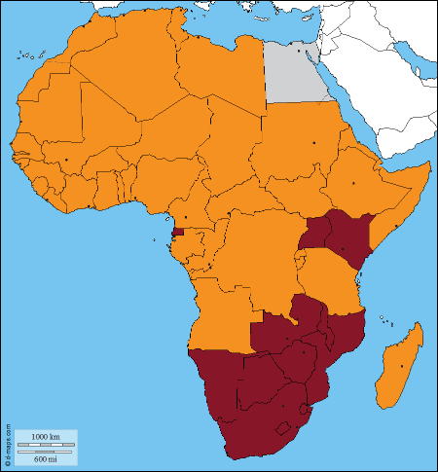
What about low prevalence countries (<5% HIV prevalence)?
Former Integrated Platforms were originally designed for high throughput high prevalence h countries.
Effective for these types of countries but not necessarily for low prevalence countries
In spite of recent evolutions of these systems, they don’t (yet) meet the needs of irregular active files/low prevalence countries
Risk of getting « neglected countries » left behing, involving delay in VL scale up
73% of African countries are <5% HIV prevalence countries
West and Central Africa remains far behind:
17% of the PLHIV worldwide live in WCA
1 in 5 patient only with VL test access
25% of deaths among adults
40% among children occur in WCA
There is a need to fill this VL acess gap by
Supporting innovative and efficient technologies adapted to local conditions
Strengthening the medical environment
HIV prevalence <5%
HIV prevalence >5%

Slide 8
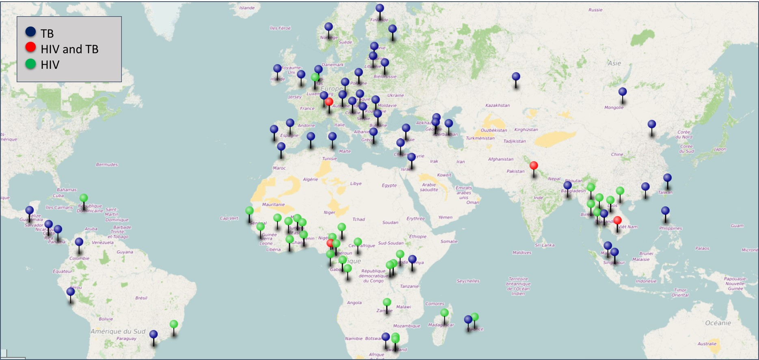
Low prevalence countries : already a
worldwide market for OPP like platforms …
… but not a panacea !

Slide 9
To conclude : key messages
Mixing Scale and Scope
Flexibility and polyvalence are the new key words
… even if this is still in course of achievement
This evolution has to be strongly encouraged
There is no « one size fits all »
Even in the same country, different systems may be needed to face the local condition.
A much more diversified offer is now available on the supply side
The strategic question is how this diversity is used to meet the local need.
The complementarities between systems should be best exploited.

Slide 10
Thanks for your attention

Slide 11
Disclosure of speaker's interests
No (potential) conflict of interests

Slide 12
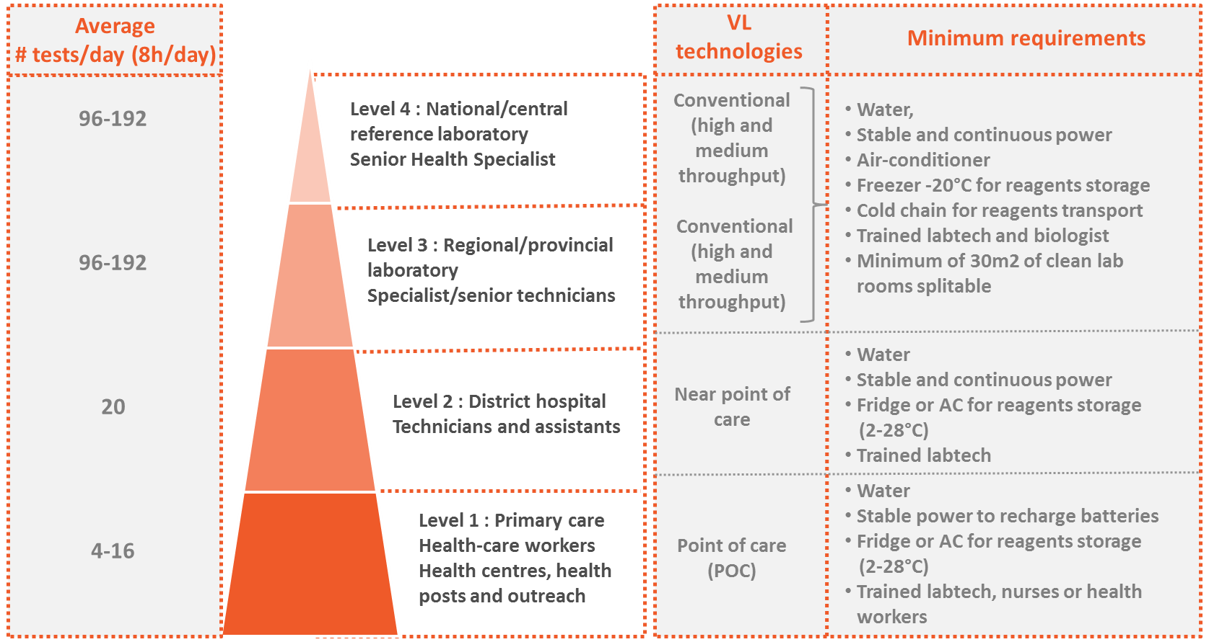
Complementarity of the systems

Slide 13
OPP market watch (2017): a dynamic market open to further evolutions
Automated extraction
Reagents for HIV-1
viral load
16 reagents suppliers with CE-IVD marked
9 extractors CE-IVD
Real time PCR
Machines
Polyvalence : multiple diagnostics
- HBV : 5 kits CE-IVD marked
- HVC : 3 kits CE-IVD marked
- Tuberculosis: 10 kits CE-IVD
12 machines CE-IVD

Slide 14
Combining scale and scope : the complementarity between systems
Actually : some clear complementarities …
Integrated platform
Largely based on economies of scale & high volume throughputs ➔ batch series (minimum of series) versus flexible system ➔ if the we do not use all the capacity, the loss of efficiency may be important. ➔ the recent evolutions mitigates this limit
OPP
Economic benefits may be induced by the production of multiple goods, which may be interrelated (EID) or have no relationship (TB) ➔ if the we do not use all the capacity, the loss of efficiency is not important ➔ large benefits of economies of scale
Points of Care
No real rivals in rural zones with dispersed patients. ➔ Low-throughput. Seem better adapted for EID than HIV VL (1-40 samples per week)
… But a the dynamism of the market is opened to new evolutions

